Slide 1


IBM Db2 to Db2
on Cloud
IBM
Cloud

Slide 2

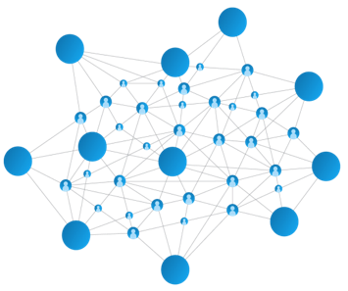
The AI Ladder
A prescriptive, proven approach to accelerating the journey to AI
INFUSE – Operationalize AI with trust and transparency
AI
ANALYZE - Scale insights with AI everywhere
ORGANIZE - Create a trusted analytics foundation
COLLECT - Make data simple and accessible
MODERNIZE
your data estate for an AI and multicloud world
Data of every type, regardless of where it lives

Slide 3
Db2 Warehouse
on Cloud
—
Cloud data warehouse delivered as a service
Db2
on Cloud
—
Transactional data store delivered as a service
NPS
—
Cloud data warehouse running the next-gen Netezza engine
Cloud/SaaS
Cloud/SaaS
Cloud Pak for Data
Our family of data stores
spanning ground to cloud
It’s all about choice
& perfect fit
IBM Cloud
IBM Cloud
IBM Cloud
AWS
AWS
AWS
Integrated Analytics System
—
Dedicated analytics appliance based on Db2 Warehouse engine
Db2
Warehouse
—
Analytics-tuned relational database
Db2
—
Highly-performant transactional data store
Netezza Performance Server
—
Next-gen Netezza engine in a system form factor
Cloud Pak for Data
Cloud Pak for Data
Cloud Pak for Data
IBM Data & AI, Hybrid Data Management
©2020 IBM Corporation

Slide 4
$1
1. Understanding Cloud
Why should you chose to move to cloud? What advantages do you gain from a cloud environment on a strategic level?
2. Understanding Db2 on Cloud
Why Db2 on cloud is the organic choice for existing Db2 users
3. Total Cost of ownership
On prem vs cloud. Db2 on cloud vs competitors.
IBM ©2019 IBM Corporation

Slide 5
Benefits of Cloud
Pay for the resources you use
As opposed to on-prem, customers have the ability to pay for usage and scale up/down as needed.
Agility and speed to innovation
With the wide range of services available on cloud, building systems is easier. Cloud shortens the journey from ideation to implementation – helping you compete in the market place!
Lower maintenance
Because cloud software is hosted for you, you don’t need to worry about the maintenance of your software or the hardware it resides on, compatibility and upgrades are taken care of by the cloud service provide
…And much more!
IBM ©2019 IBM Corporation
Notes:
Lower maintainance – polish the point

Slide 6
IBM
Db2 on Cloud
a fully-managed, high performance, highly available cloud transactional SQL database
Cloud
Our value proposition:
1
Save time by deploying Db2 on the cloud vendor of your choice with a click of a button
2
Help database administrators by taking care of the back-end operational tasks
3
Reduce total cost of ownership by upto 83%* compared to on-prem
*Calculations provided on slide 9
IBM ©2019 IBM Corporation

Slide 7
Deploying Db2 on your own – the current process
1
2
3
4
5
Procure Db2 licenses and infrastructure separately
Enterprises buy typical Db2 on prem licenses and procure appropriate hardware. The enterprise is responsible for setting up and maintaining the infrastructure.
Deploy Db2 on VM’s or K8’S
Enterprises can either install Db2 on VM’s or using Kubernetes. Both of these options require the in-house technical team to gain expertise in new areas and slows down the process of getting the system up.
Understand how to set up HA and DR – then implement it.
Enterprises are left to architect their own solutions on how to maintain a highly available system. Implementing the solution, taking into account geographical isolation and seamless failover, is challenging.
Set up security and compliances
Enterprises are left to understand and manage their own security measures, and seek compliances for their system to satisfy industry/government requirements.
Lot of day to day manual labor and maintenance
Once the system is set up, enterprises are responsible for the following tasks – (i) software updates (ii) security patches (iii) backups (iv) networking
… these steps can take anywhere from 4-8 months with limited ability to scale
IBM ©2019 IBM Corporation

Slide 8
Introducing Db2 on cloud – a DBA’s best friend
1
Deploy Db2 on cloud on either AWS or IBM Cloud and start working on your database.
We provide:
High Availability
Rolling Updates
Backups
Disaster Recovery
Instant scale up/down
Security
Hardware
Networking
… and much more!
IBM ©2019 IBM Corporation

Slide 9
Reduce your total cost of ownership by upto 83%
 | Db2 on Premise (AESE) | Db2 on Cloud (IBM Cloud) | Db2 on Cloud (AWS)
Db2 cost per core/year | $7,800 | $2,268 | $7800
Server* cost per core /year (hardware + rack cost of ~$150k over 3 years for 12 core system) | $4,000 | Included | Included
Storage Cost* | $4USD/GB | $1USD/GB | $1USD/GB
Support Cost/year* | $500 | Included | Included
Network Cost per core* /year($63,000 over 3 years for 12 core system) | $1000 | Included | Included
Average Cost/Core | ~$13,300 | $2,268 | $7800
Cost comparison of 10core/200GB Db2 Database/year | $140,800 | $10,284 | $80,400
*Fully loaded cost
Notes:
Storage cost
Compare Db2 on cloud (IBM) vs. Db2 on cloud (aws) vs aws vs azure
Same HA, DR available , EU cloud

Slide 10
IBM
Db2 on Cloud
Fully managed
by our DevOps team 24x7x365
Highly-available
99.99% uptime with high availability node
Scalable & elastic
with independent scaling of storage & compute
High performance and easy to use
Powered by the Db2 engine
Reliable
Offsite DR node and 14 day backup
No vendor lock-in
Now available on AWS and IBM Cloud
IBM ©2019 IBM Corporation

Slide 11
Choose from two
cloud deployment options
IBM
Cloud
The future is choice
IBM ©2019 IBM Corporation

Slide 12
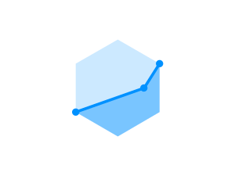

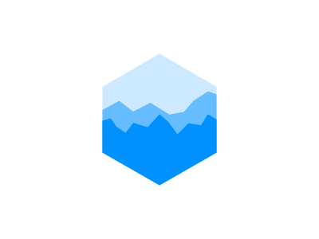
Fully-managed
by our world-class DevOps team, 24x7x365
Our DevOps team is composed of experts in managing Db2 and cloud-based offerings.
We take care of…
operating system updates and patches
rollout of new offering features, including engine updates and console enhancements
self healing for unexpected software and hardware failure
automated daily backups for the worst case scenario
…we’re on-call 24x7x365, so you can focus
on more important things
IBM ©2019 IBM Corporation

Slide 13
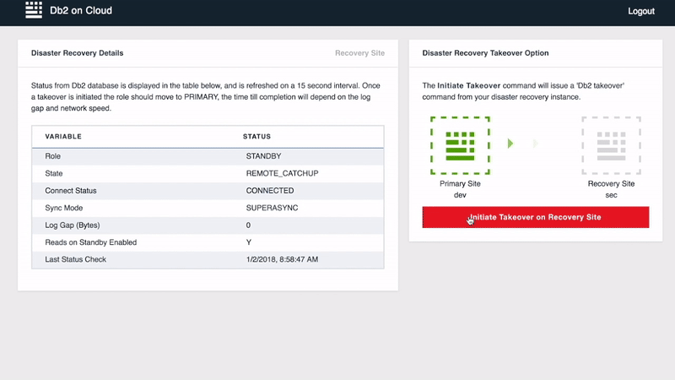
High Availability and Disaster Recovery
Up and Running, even when disaster hits to ensure business continuity
99.99% Uptime SLA
&
Disaster Recovery Failover with 1-click
IBM ©2018 IBM Corporation

Slide 14


High Availability Configuration
Up and Running, even when disaster hits to ensure business continuity
Client
Active DR node
Integrated Cluster Management
-Health of servers monitored
-Automated takeover
Automatic Client Reroute
Clients transparently connect to standby when primary fails
Primary Server
Transaction Log Record Shipping
Keeps standby current and synchronous
Standby Server
IBM ©2018 IBM Corporation

Slide 15
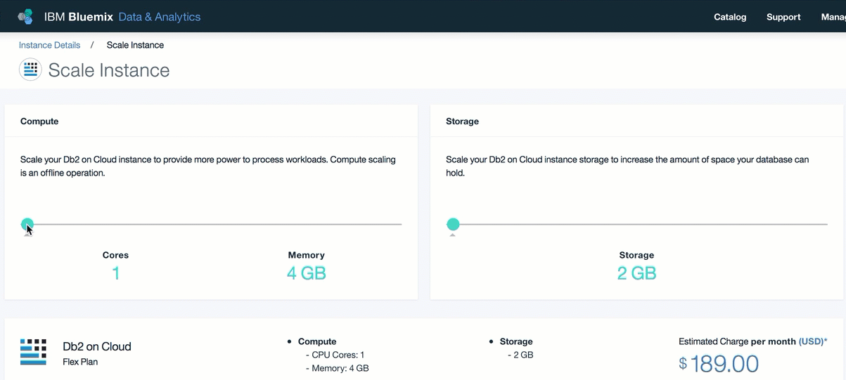
Scalable
with independent scaling of storage and compute, with
slider-bars
Scale your compute
during peak demand or
when demand falls
Ramp up your data storage
as you data needs grow
Sit back and relax.
You don’t need experts.
<40 mins
For HA couple
IBM ©2018 IBM Corporation

Slide 16
Other key features
$1
Homogeneous data management
With the same engine for on-prem and cloud workloads, no code has to be changed
Easily scales with your growing business
Start with the lite plan, deploy with one click. Gradually expand to flex or precise performance depending on your business needs
Top level security
Data is encrypted at rest and during transit. Certifications include – ISO 27001, 27017/18, HIPAA, SOC2 Type 2, Privacy Shield, GDPR
Control your cloud costs with all-in pricing
No hidden fees. No surprise bill at the end of the month. Pay only for what you use.
GDPR AND EU Cloud
EU Cloud is an IBM Initiative that expands upon GDPR requirements and makes sure EU Data that stays in EU is managed and supported by EU Citizens from within EU. Frankfurt DC supports EU Cloud
IBM ©2019 IBM Corporation

Slide 17
Choosing the right plan – IBM Cloud
 | Lite | Flex | Precise Performance | Hybrid Flex
Use case | Simple use cases | Dynamically scale both RAM and storage with flexible pricing. Used for production workloads. | Used for workloads that require high performance | Similar to flex but purchased using HDMP
Base Cost | Withdrawn | $189/core | Starts at $250/core | $189/core
Compute |  | 4GB/core + $13/GB | 8GB – 1TB RAM | 4GB/core + $13/GB
High Avail. | - | $189/core | Starts at $250/core | $189/core
Storage | - | 2GB included + $1/GB | 500 GB – 11TB | 2GB included + $1/GB
Disaster R | - | $189/core | Starts at $250/core | $189/core
IBM ©2019 IBM Corporation

Slide 18
Core Specs & Prices
Same price per core as Db2 for HDMP Monthly. ($650 per core per month.)
4 core minimum.
Includes 100 GB of storage
Extra storage $1 per GB
High Availability doubles cost of cores and storage
Includes 1TB of data transfer free. After that, same rates as Amazon apply.
Details
Runs Db2 Advanced. (Aka Db2 AESE.)
On request, each customer can obtain a private VPC just for them, so there is no risk of neighbors causing issues.
Very fast provisioned IOs.
Standard Edition coming in 2020 for lower-end or development workloads.
SUMMARY
Db2 on Cloud
For AWS

Slide 19
Availability Zones: 20 Data Centers across the World
Dallas *
Washington DC *
San Jose
Toronto
Montreal
Queretaro
Sao Paolo
London *
Amsterdam *
Paris *
Milan
Oslo
Frankfurt**
Sydney *
Melbourne
Singapore
Hong Kong
Seoul
Chennai
Tokyo *
* Instant provisioning for virtual systems
** EU Cloud
Notes:
Master Draft 1
Master Draft 1
19

Slide 20
What makes Db2-on-cloud the organic choice for existing on-prem Db2 users?
IBM ©2019 IBM Corporation

Slide 21
Same Db2 engine – and that means a lot…
1
2
3
4
5
Homogenous Data Migration
Move your on-prem workloads faster to cloud. With the same Db2 engine as on-prem, there’s little change to in database code or SQL query optimization.
BYOL Program
Existing Db2 users get discounted prices for Db2 on cloud. Program is designed to make sure our customers are not over paying.
Available on multiple clouds – no vendor lock in
With Db2 on cloud now on AWS and IBM Cloud, we have one message for our customers – we go where you go.
Lower Total Cost of Ownership
Fully managed offering means that less personnel is dedicated to managing the database itself, freeing up resources for core business workstreams for our client
Unified console across cloud and on-prem
With the same user experience as on-prem console, no resources are wasted in re-training DBA’s or engineers
IBM ©2019 IBM Corporation

Slide 22
Same experience, everywhere
Db2 Unified Console
Build & Built for your client
You can extend and join each of your consoles through a single enterprise console. Open APIs, SNMP, and a composable interface make integration easy. Security, HA and recoverability are built in.
The same experience from ground to cloud
The same user experience means lower training costs, higher productivity and greater project success across your IBM hybrid data enterprise.
Walk up and use
There is nothing to install to get started. Each offering includes the same easy and intuitive experience for new and demanding users.
Notes:
Master Draft 1
Master Draft 1
22
Hybrid Data Management is unifying its user experience across the Db2 family of databases
We are delivering a single experience from group to cloud
Full function is available without installing any separate tools
Load Data, Manage Objects, Administer Users and Security, Manage Recoverability and Monitor and Optimize workloads from a single interface
Smart monitoring and alerts that learn the difference between normal and unusual behavior
These are deep tools that allow users to start simple and grow with their experience
You can tie all your servers from ground to cloud together onto a single pane of glass
You can access anything on the screen through a complete set of open RESTful APIs to extend your experience and integrate it into your enterprise management stack
Customize for your client
Everything we have in the UI has a restful service. Full programming interface is available. Manipulate objects, change privileges, change your monitoring configurations, samples for python, javascript.
BPs, add some monitoring capabilities, pull parts of the UI together, then you can.
They can customize the environment for the webpage.
They can set it up, with a few codes of html to drop this into a web page.

Slide 23

Db2 on Cloud vs Db2 Hosted vs Db2 on CPD
 | Db2 on Cloud | Db2 on CPD today | Db2 Hosted
All issues covered
Software issues |  | Customer managed | Customer managed
Rolling updates |  |  | Customer managed
High availability |  |  | Customer managed
Backups |  |  | Customer managed
Web console tools |  | Optional | None
Software security |  | Customer managed | Customer managed
Scale up & down on demand |  | OCP managed
Hardware |  | Customer managed
Network |  | Customer managed
Root access | No
** Db2 Warehouse on Cloud is the same as Db2 on Cloud (fully managed), but it is designed for warehousing. It uses an MPP cluster, is optimized for warehousing and supports well over 40TB of data. (However, Warehouse is not optimized for smaller transactions, like Db2 on Cloud.)

Slide 24
\
How am I going to migrate my data to the Cloud?
IBM ©2019 IBM Corporation

Slide 25
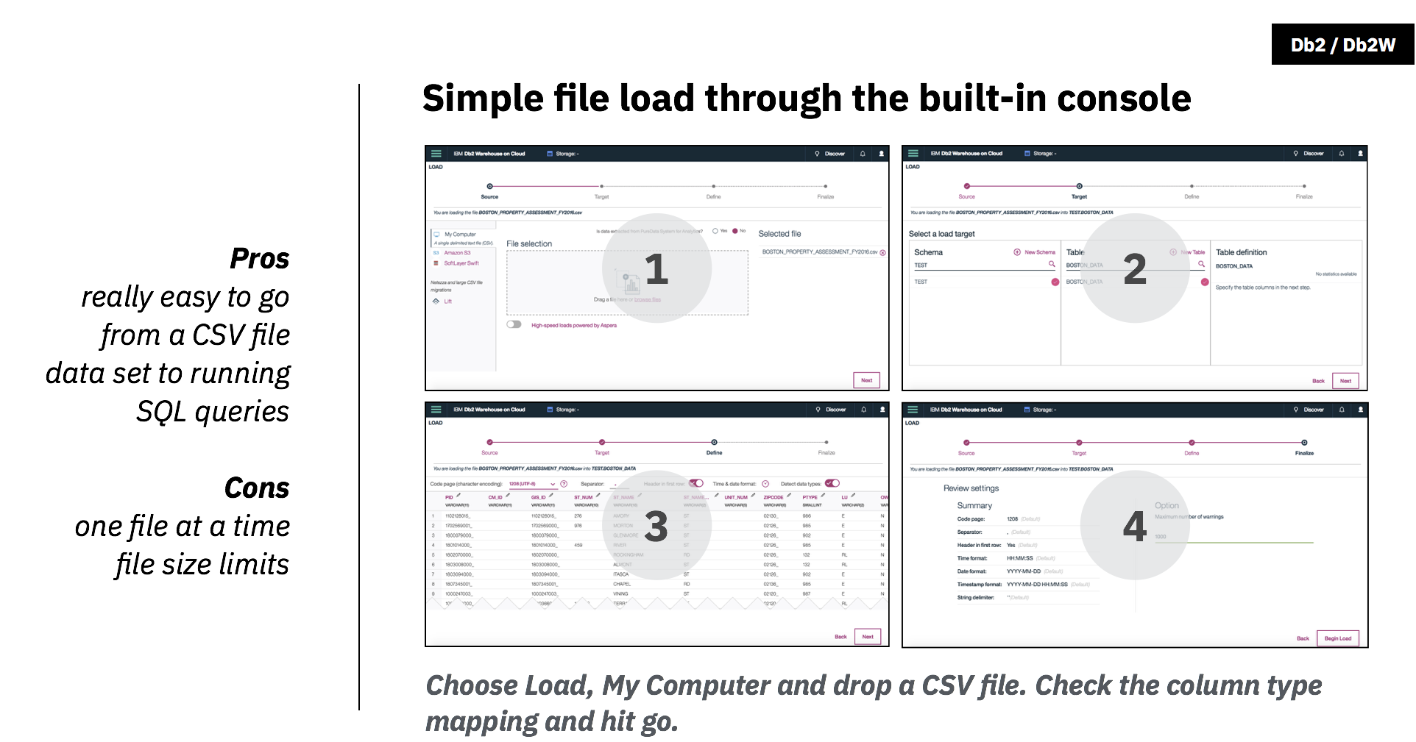
\

Slide 26
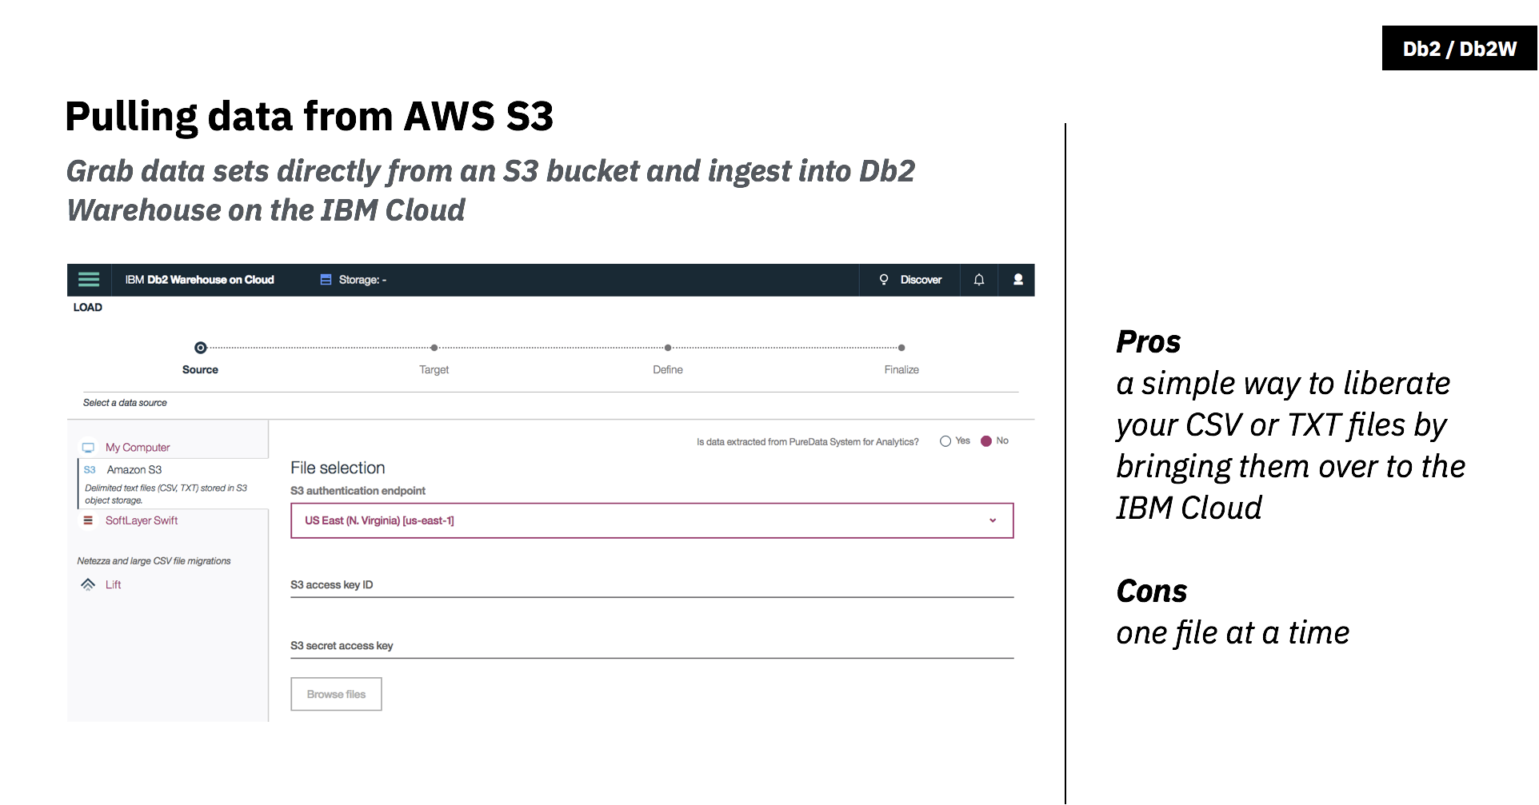

Slide 27
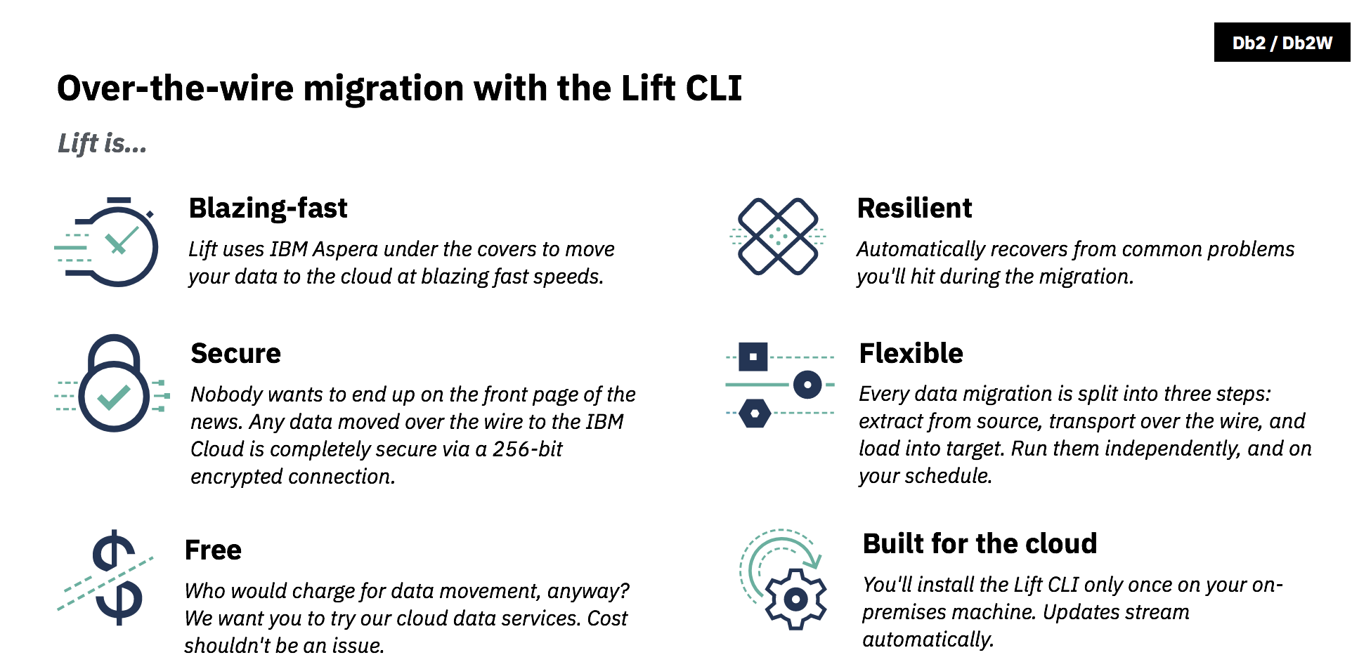

Slide 28
© 2018 IBM Corporation

